Slide 1
Introduction to Statistical Methods
ISM Team

Slide 2
Session – 11
Correlation & Regression

Slide 3
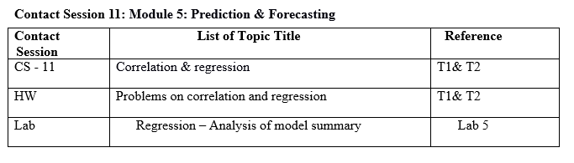
Contact Session 11

Slide 4
In case of bivariate and multivariate populations, usually, we have to answer two types of questions:
Q1: Does there exist correlation (i.e., association) between two (or more) variables?
If yes, of what degree?
Q2: Is there any cause and effect relationship between the two variables (in case of bivariate population) or one variable in one side and two or more variables on the other side (in case of multivariate population)?
If yes, of what degree and in which direction?
To find solutions to the above questions, two approaches are known.
Correlation Analysis
Regression Analysis

Slide 5
Correlation Analysis

Slide 6
Example: Wage Data
A large data regarding the wages for a group of employees from the western region of a country is given.
In particular, we wish to understand the following relationships:
Employee’s age and wage: How wages vary with ages?
Calendar year and wage: How wages vary with time?
Employee’s age and education: Whether wages are anyway related with employees’ education levels?

Slide 7
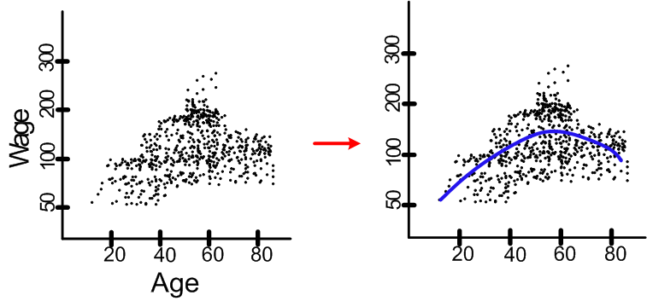
Case I. Wage versus Age
Employee’s age and wage: How wages vary with ages?
Interpretation: On the average, wage increases with age until about 60 years of age, at which point it begins to decline.

Slide 8

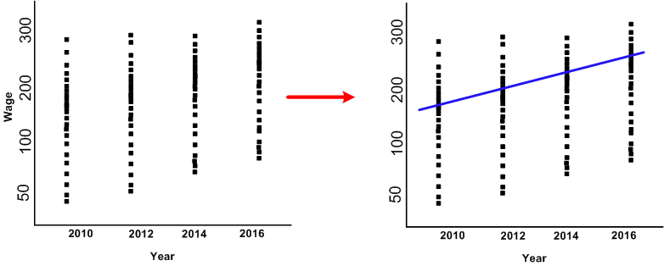
Case II. Wage versus Calendar
Wage and calendar year: How wages vary with years?
.
Interpretation: ?

Slide 9
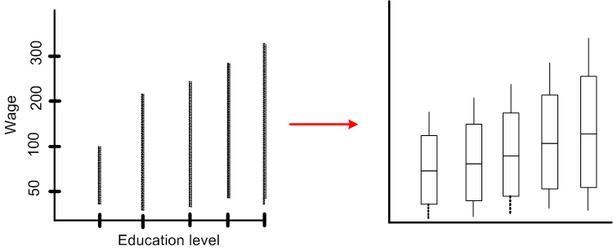
Case III. Wage versus Age
Wage and education level: Whether wages vary with employees’ education levels?
Interpretation: ?

Slide 10
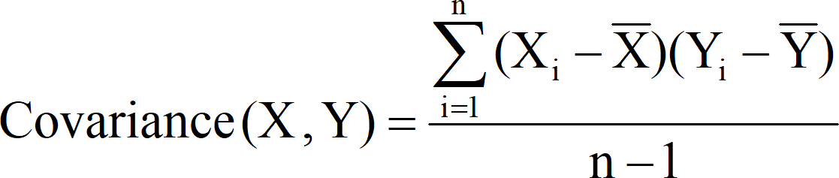
Covariance
The statistical technique used for studying the existence and extent of relationship among 2 or more variables is through Covariance
|

Slide 11
So in bivariate and multivariate case, the statistical technique used for studying the existence of relationship between all variables is through Covariance.
Covariance signifies the direction of the linear relationship between the two variables.
By direction we mean if the variables are directly proportional or inversely proportional to each other. (Increasing the value of one variable might have a positive or a negative effect on the value of the other variable).
|

Slide 12
The values of covariance can be any number between the two opposite infinities. Also, it’s important to mention that covariance only measures how two variables change together, not the dependency of one variable on another one.
The upper and lower limits for the covariance depend on the variances of the variables involved. These variances, in turn, can vary with the scaling of the variables. Even a change in the units of measurement can change the covariance. Thus, covariance is only useful to find the direction of the relationship between two variables and not the magnitude.
|

Slide 13
If X₁ and X₂ are two variables, the covariance between X₁ and X₂is defined as
n
∑(X₁ − X1 )(X₂ − X2 )
Cov(X₁, X₂ ) = ^{i=1}
n −1
|

Slide 14
Even though the covariance explains the relationship between two or more variables, the units the measurement of variable is attached with the value of the covariance. If they have different unit of measurements, based on the sign it is possible to say whether they are related or not, but the degree (strength) of relationship is not possible to decide based on the value of covariance due to different units of measurement.
|

Slide 15
Example 1 :
Find the covariance between age (months) and weight (kgs) for the following data
Age (years) | 7 | 6 | 8 | 5 | 6 | 9
Weight (kgs) | 12 | 8 | 12 | 10 | 11 | 13
|

Slide 16
Solution -1
Age (yrs) (X) | Weight (kgs) (Y) | (X − X) | (Y − Y) | (X − X)(Y − Y)
5 | 20 | -2 | -3 | 6
4 | 18 | -3 | -5 | 15
7 | 23 | 0 | 0 | 0
10 | 32 | 3 | 9 | 27
8 | 26 | 1 | 3 | 3
8 | 25 | 1 | 2 | 2
∑X = 42 | ∑X = 144 |  |  | ∑(X − X)(Y − Y) = 53
Cov(X, Y) = ⁵³ = 10.6 years.kgs → Interpret this answer !
5
|

Slide 17
Covariance based on Probability distribution.
If X and Y are two random variables with probability mass function p(x)/ probability density function f(x), then the covariance between X and Y
Cov (X, Y) = E[(X-µ_{X})(Y-µ_{Y})] = E(XY) – E(X)E(Y)
where E(X) = µ_{X} and E(Y) = µ_{Y} are the means of X and Y.
|

Slide 18
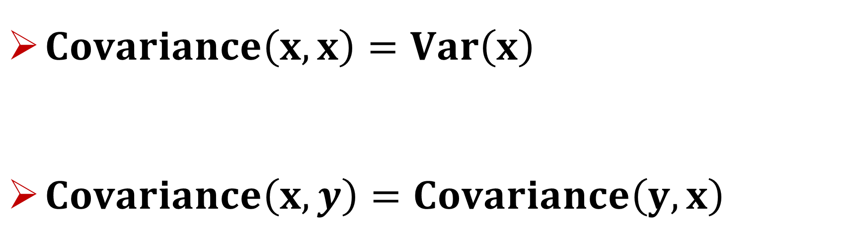
$Covariance\left(x,x\right)=Var\left(x\right)$
$Covariance\left(x,y\right)=Covariance\left(y,x\right)$
|

Slide 19
Application of Covariance.
1. Multivariate linear regression:
If there a dependent variable and n independent variables, to find out the relationship between these (n+1) variables, a variance – covariance matrix will be helpful.
2. Time series:
In the given series of data over the time, it helps in finding the autocorrelation at different time lags. For example, if X_{t1} , X_{t2} , . . . , X_{tn} denote the time series data over a given period, then the autocovariance
|

Slide 20
If X₁, X₂, …, X_{n} are n variables, then the Covariance between these n variables is the Variance – Covariance matrix given by
. . .
ο . . . σ
. . . .
. . . .
. . . .
ο _{n 2} . . .
where
⎡^{σ}11 ^{σ}12
^{σ}12 ⎤
⎢_{σ}
⎥
2n _{⎥ σ ij = ⎨}
⎧Variance, for i = j
⎢
21 22
. ⎥
. ⎥
⎩Covariance, for i ≠ j
Σ = ⎢ .
⎢ .
All diagonal elements in the
⎢
⎥
variance-covariance matrix are variances and off diagonal elements are covariances.
Σ is a symmetric matrix.
⎢ .
. ⎥
⎢
⎥
⎢⎣^{σ} n1
^{ο} n1 ⎥⎦
|

Slide 21
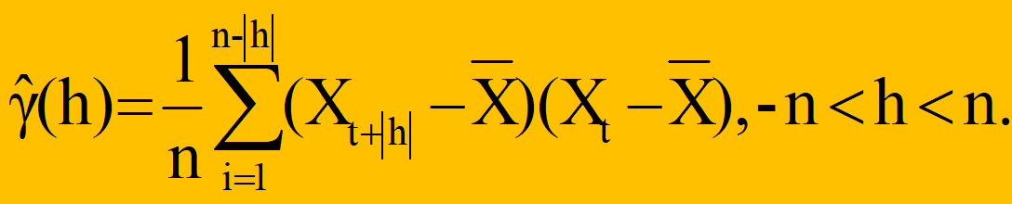
Application of Covariance. at lag h is given by
γ_{X}(t+h, t) = Cov (X_{t+h}, X_{t})
For example, if X_{t1}, X_{t2}, . . . , X_{tn} denote the time series data over a given period, then the auto-covariance.
The auto-covariance at lag h is then given by
|

Slide 22
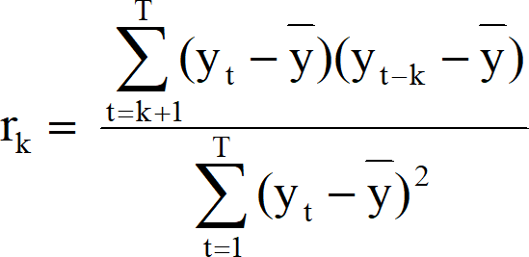
Application of Covariance.
With the help of auto-covariance, the autocorrelation is given by
|

Slide 23
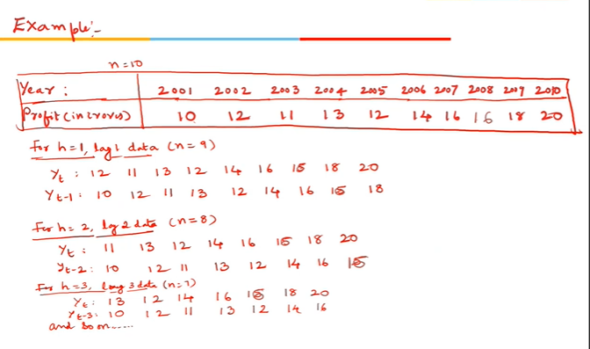
Application of Covariance.
With the help of auto-covariance, the autocorrelation is given by
|

Slide 24
Karl Pearson’s Correlation coefficient
To overcome this, Karl Pearson’s suggestion was to divide the covariance of the variables by their respective standard deviations. The ratio of covariance to the product of standard deviations is called Karl Pearson’s product moment correlation, which is free of unit of measurement.
Karl Pearson’s product moment correlation returns a numerical value, popularly known as Coefficient of Correlation, denoted by ‘r’
Correlation coefficient is a statistic that assesses the strength and direction of relationship of two continuous variables
|

Slide 25
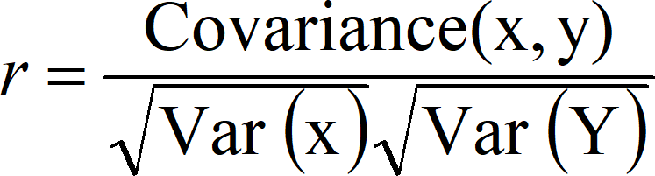
Formula for computing Karl Pearson’s correlation coefficient (r) is standardized covariance (unit less)

Slide 26
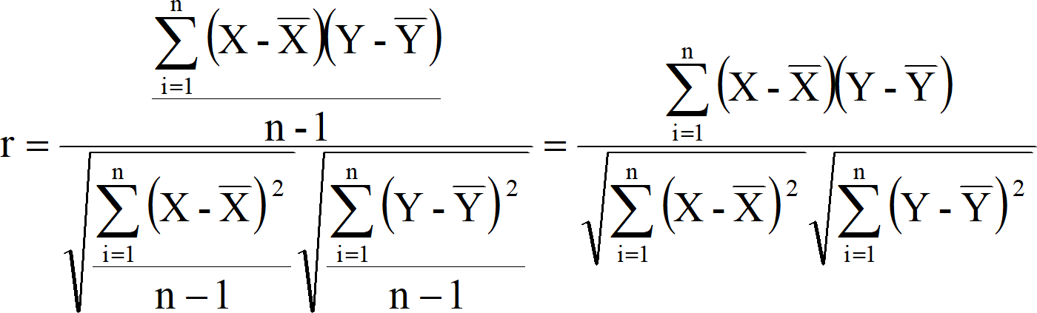
|

Slide 27
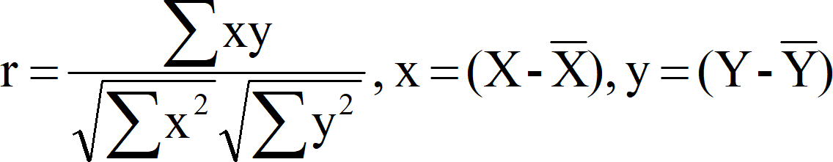
Karl Pearson’s Correlation coefficient
Or alternatively we can use
|

Slide 28
Simple Correlation coefficient
If the sign is +ve this means the relation is direct (an increase in one variable is associated with an increase in the other variable and a decrease in one variable is associated with a decrease in the other variable).
If the sign is -ve this means an inverse or indirect relationship (an increase in one variable is associated with a decrease in the other).
The value of r ranges between ( -1) and ( +1), i.e., -1 ≤ r ≤ +1
The value of r denotes the strength of the association as illustrated by the following diagram.
|

Slide 29

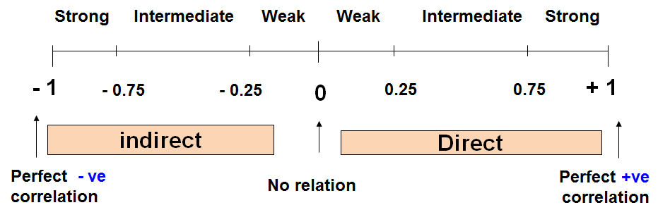
|

Slide 30
Simple Correlation coefficient
r = - 1 ⇒ Perfect negative correlation
0.99 to - 0.76 ⇒ Strong negative correlation
0.75 to - 0.26 ⇒ Intermediate (Moderate) negative correlation
0.25 to 0 ⇒ Weak negative correlation r = 0 ⇒ Zero correlation
0 to 0.25 ⇒ Weak positive correlation
0.26 to 0.75 ⇒ Intermediate (Moderate) positive correlation
0.76 to 0.99 ⇒ Strong positive correlation r = = 1 ⇒ Perfect positive correlation
|

Slide 31
Example
Serial No | Age (yrs) | Weight (Kg)
1 | 7 | 12
2 | 6 | 8
3 | 8 | 12
4 | 5 | 10
5 | 6 | 11
6 | 9 | 13
|

Slide 32
Solution
Sl no. | Age (yrs) (X) | Wt (Kg) (Y) | XY | _{X}2 | _{Y}2
1 | 7 | 12 | 84 | 49 | 144
2 | 6 | 8 | 48 | 36 | 64
3 | 8 | 12 | 96 | 64 | 144
4 | 5 | 10 | 50 | 25 | 100
5 | 6 | 11 | 66 | 36 | 121
6 | 9 | 13 | 117 | 81 | 169
Total | ∑X=41 | ∑Y=66 | ∑XY= 461 | ∑X²= 291 | ∑Y²= 742
|

Slide 33
Karl Pearson’s Correlation coefficient
𝑛 ∑ 𝑋𝑌 − (∑ 𝑋)(∑ 𝑌)
𝑛 ∑ 𝑋! − ∑ 𝑋 ! 𝑛 ∑ 𝑌! − ∑ 𝑌 !
𝑟 =
6 ∗ 461 − 41 ∗ 66
6 ∗ 291 − (41)! 6 ∗ 742 − (66)!
𝑟 =
r = 0.759 (Positive (Direct) strong correlation)
|

Slide 34
Karl Pearson’s Correlation coefficient
Example: Relationship between anxiety and test Scores
Anxiety (X) | Test score (Y) | _{X}2 | _{Y}2 | XY
10 | 2 | 100 | 4 | 20
8 | 3 | 64 | 9 | 24
2 | 9 | 4 | 81 | 18
1 | 7 | 1 | 49 | 7
5 | 6 | 25 | 36 | 30
6 | 5 | 36 | 25 | 30
∑X = 32 | ∑Y = 32 | ∑X² = 230 | ∑Y² = 204 | ∑XY= 129
|

Slide 35
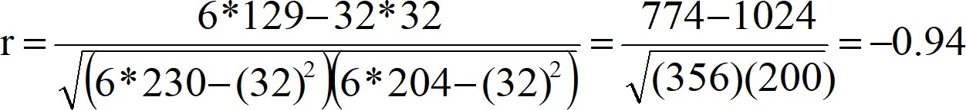
s
Karl Pearson’s Correlation coefficient
Correlational Analysis
𝑛 ∑ 𝑋𝑌 − (∑ 𝑋)(∑ 𝑌)
𝑛 ∑ 𝑋! − ∑ 𝑋 ! 𝑛 ∑ 𝑌! − ∑ 𝑌 !
𝑟 =
r = - 0.94 (Negative (Indirect) strong correlation )
|

Slide 36
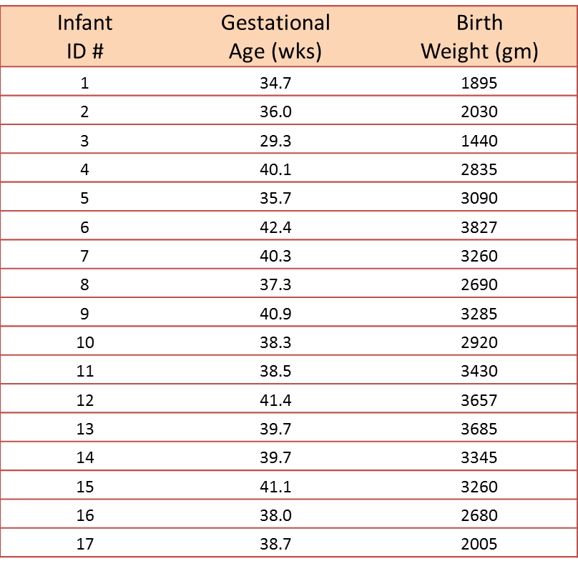
Example : A small study is conducted involving 17 infants to investigate the association between gestational age at birth, measured in weeks, and birth weight, measured in grams.

Slide 37
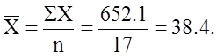
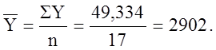
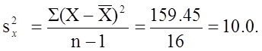
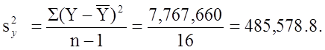
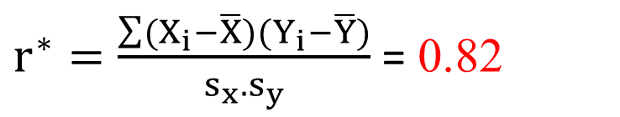
Solution :
In this example, birth weight is the dependent variable and gestational age is the independent variable. Thus Y = birth weight and X = gestational age.
For the given data, it can be shown the following
$r^{∗}=\frac{\sum{(X_{i}−\overline{X})(Y_{i}−\overline{Y})}}{s_{x}.s_{y}}$ = 0.82
Conclusion: The sample’s correlation coefficient indicates a strong positive correlation between Gestational Age and Birth Weight.

Slide 38
Homework Problems
Q1) Consider the following data.
Expenditure (in 1000 Rs) | 30 | 70 | 40 | 20 | 10 | 40 | 10 | 20
Actual Sales(in 1000 Rs) | 10 | 16 | 19 | 14 | 17 | 16 | 13 | 18
For the above data,
i) Find coefficient of correlation between expenditure and actual sales. [Ans = 0.8108]
ii) Find rank correlation between expenditure and actual sales. [Ans = - 0.2424 ]
Q2) Find coefficient of correlation between X & Y.
X | 79 | 29 | 45 | 61 | 24 | 38 | 33 | 52 | 65 | 63 | 82 | 50
Y | 15 | 12 | 12 | 6 | 6 | 7 | 3 | 10 | 12 | 13 | 13 | 14
Ans = r= 0.59
Q3) Check whether X and Y are having any relation.
X | 12 | 14 | 15 | 17 | 17 | 16 | 16 | 15 | 14 | 14
Y | 52 | 52 | 57 | 62 | 67 | 67 | 67 | 62 | 62 | 52
Ans = r = 0.7866

Slide 42
CORRELATION | REGRESSION
Measuring strength or degree of the relationship between two variables | Having an algebraic equation between two variables
No estimation | Estimation
Both variables are independent | One is dependent variable and the other is independent variable

Slide 54
Assumptions of the Linear Regression
Assumptions about the Error
E(ε_{i} ) = 0 for i = 1, 2,…,n.
σ(ε_{i} ) = σ_{ε} where σ_{ε} is unknown.
The errors are independent, that is, the error in the ith observation is independent of the error observed in the jth observation.
The ε_{i} are normally distributed (with mean 0 and standard deviation σ_{ε}).

Slide 55
Coefficient of Determination (R2) : % of accountable variation in the dependent variable explained by the variation in independent variable

Slide 56
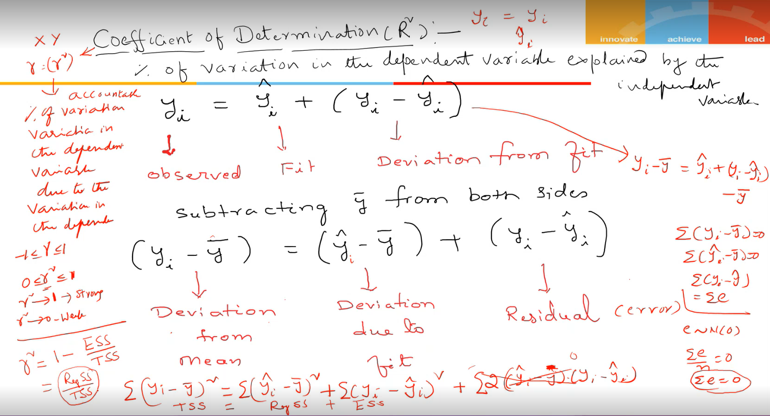
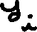


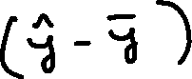




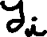

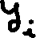



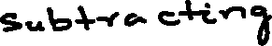





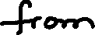
Coefficient of Determination (R2) : % of accountable variation in the dependent variable explained by the variation in independent variable

Slide 58
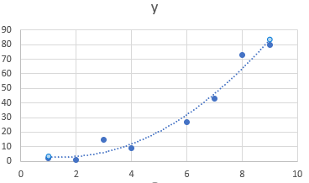
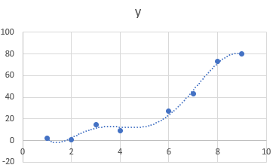
Overfitting
Which of these two models would be a better fit to the data?

Slide 59
Multicollinearity
It refers to the phenomenon of having related predictor variables in the input dataset.
In simple terms, in a model which has been built using several independent variables, some of these variables might be interrelated, due to which the presence of that variable in the model is redundant. You drop some of these related independent variables as a way of dealing with multicollinearity.
Multicollinearity affects:
Interpretation:
Does “change in Y, when all others are held constant” apply?
Inference:
Coefficients swing wildly, signs can invert
p-values are, therefore, not reliable

Slide 60
Dealing with Multicollinearity
Two basic ways of dealing with multicollinearity
Looking at pairwise correlations
Looking at the correlation between different pairs of independent variables
Checking the Variance Inflation Factor (VIF)
Sometimes pairwise correlations aren't enough
Instead of just one variable, the independent variable might depend upon a combination of other variables
VIF calculates how well one independent variable is explained by all the other independent variables combined

Slide 61
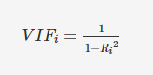
Variance Inflation Factor (VIF)
The VIF is given by:
where 'i' refers to the i-th variable which is being represented as a linear combination of rest of the independent variables.
The common heuristic we follow for the VIF values is:
> 10: Definitely high VIF value and the variable should be eliminated.
> 5: Can be okay, but it is worth inspecting.
< 5: Good VIF value. No need to eliminate this variable.

Slide 63
Multiple Linear Regression

Slide 71
R – Squared vs Adjusted R - Squared
In multiple regression, adjusted R – squared is better metric than R – squared asses the goodness of fit of the model
R – squared always increases if additional variables are added into model , even if they are not related to the dependent variable

Slide 72
Lasso & Ridge
OLS estimation:
LASSO estimation:
Ridge regression estimation:

Slide 73
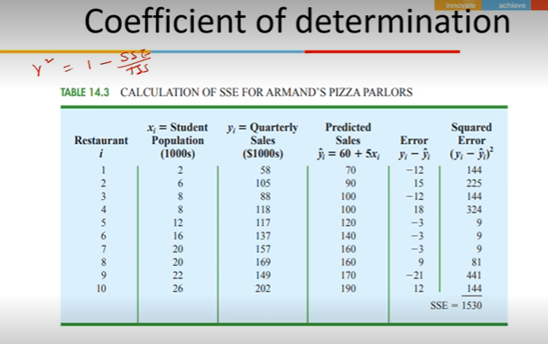

Slide 74
